Slide 1
Introduction to Directed Acyclic Graphs in Econometrics
Bruno Petrungaro
Senior Healthcare Analyst – Econometrician
The Health Economics Unit

Slide 2
What is Econometrics?
Econometrics is the branch of economics concerned with the empirical estimation of economic relationships, models, together with data, represent the basic ingredients of any econometric study
A model is a simplified representation of an actual phenomenon. The actual phenomenon is represented by the model in order to explain it, to predict it, and to control it, goals corresponding to the three purposes of econometrics, namely structural analysis, forecasting and policy evaluation
Algebraic models, which are the most important type of models for the purposes of econometrics, represent a real-world system by means of algebraic relations which form a system
Handbook of Econometrics Volume 1, 1983, Elsevier

Slide 3
Simpson’s paradox
This paradox concerns the reversal of an association between two variables that occurs when we partition a population into finer groups
A new treatment is being tested on a group of 400 men and 400 women. Half of this cohort will be in treatment group and half in control. Assignment to treatment is done at random
50% of those in treatment recovered compared to 40% in control. Therefore, the treatment has a positive effect???
In Treatment? | NO | YES
Not Recovered | 240 | 200
Recovered | 160 | 200
Fenton, N. & Neil, M., “Risk Assessment and Decision Analysis with Bayesian Networks”, CRC Press, 2019

Slide 4
Simpson’s paradox
For both men and women, the recovery rate is better without the drug!!!
Sex | Female | Male
In Treatment? | NO,YES | NO,YES
Not Recovered | 210,80 | 30,120
Recovered | 90,20 | 70,180

Slide 5
Simpson’s paradox solved
Initial Model
Revised Model
Final Model
Sex
Treatment
Sex
Treatment
Treatment
Recovery
Recovery
Recovery
Simpson’s paradox can only be resolved when causal relations are appropriately modeled

Slide 6
Association is not causation
Observing X is predictive of both Y and Z
Observing Y is predictive of both X and Z
Observing Z is predictive of both X and Y
Association is not able to make statements about interventions
X
Association: Measures correlation between variables
Y
Z

Slide 7
Causation
X
X is a cause of Y and Z
Y and Z are effects of X
If we want to change Y and Z we need to intervene on X
Causation: Infers cause and effect relationship from data
Y
Z

Slide 8
Correlation does not imply causation
Research, and this is true in healthcare as well, tends to focus on methods that maximize how accurately can we predict Y from the observed predictors X and Z and then conclude in a way which implies that a causal relationship has been established
Best predictors are not necessarily the causes of Y
It is common to find, specially in time series data, what are called spurious correlations, these are variables that are correlated but have no direct relation

Slide 9
1.2 - What is a cause? Scott Venners
https://www.youtube.com/watch?v=1FRCvbdy6IQ

Slide 10
Can we estimate the causal effect?
Sometimes!
The reason that correlation and causation are not the same is that the potential outcomes are not independent of X. In our example, it means treatment assignment was not independent of person type
Randomized control trials, due to its random assignment to treatment, solves this issue
What happens when no RCT was set?

Slide 11
Questions?

Slide 12
Structural Causal Models
Bruno Petrungaro
Senior Healthcare Analyst – Econometrician
The Health Economics Unit

Slide 13
Graphs
A graph consists of a set of vertices (nodes) V and a set of edges (arcs) E
Vertices represent variables and edges represent the connections between them
Edges can be either directed or undirected
X
Y
Z
X
Y
Z

Slide 14
Directed Graphs
Causal relationships are asymmetric. This means:
If X causes Y, then it cannot happen that Y causes X
Therefore, we need directed graphs to represent causality
Edges represent dependency:
B has parent A and child D
D has parents B and C, and ancestor A
A has children B and C, and descendant D
A
B
C
D

Slide 15
Directed Graphs example
Causal relationships are asymmetric. This means:
If Smoker causes Bronchitis, then it cannot happen that Bronchitis causes Smoker
Therefore, we need directed graphs to represent causality
Edges represent dependency:
Bronchitis has parent Smoker and child Dyspnoea
Dyspnoea has parents Cancer and Bronchitis, and ancestor Smoker
Smoker has children Cancer and Bronchitis, and descendant Dyspnoea
Smoker
Cancer
Bronchitis
Dyspnoea

Slide 16
Directed Acyclic Graphs
A directed path is a sequence of edges connecting two vertices following the direction of the edges
A cycle would happen if and only if there is a directed path from, for example, a vertex X to X (itself)
A graph containing no cycles is called acyclic
When dealing with causality, acyclic graphs are the types of graphs we need. Can anything cause itself?

Slide 17

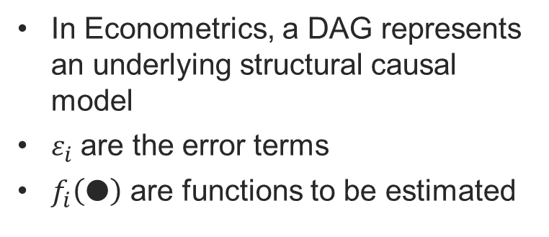
Structural Causal Models
U
X
In Econometrics, a DAG represents an underlying structural causal model
$ε_{i}$are the error terms
$f_{i}\left(●\right)$ are functions to be estimated
Y
Z
$$U=f_{1}\left(ε_{1}\right)$$
$$X=f_{2}\left(U,ε_{2}\right)$$
$$Y=f_{3}\left(X,ε_{3}\right)$$
$$Z=f_{4}\left(X,ε_{4}\right)$$

Slide 18
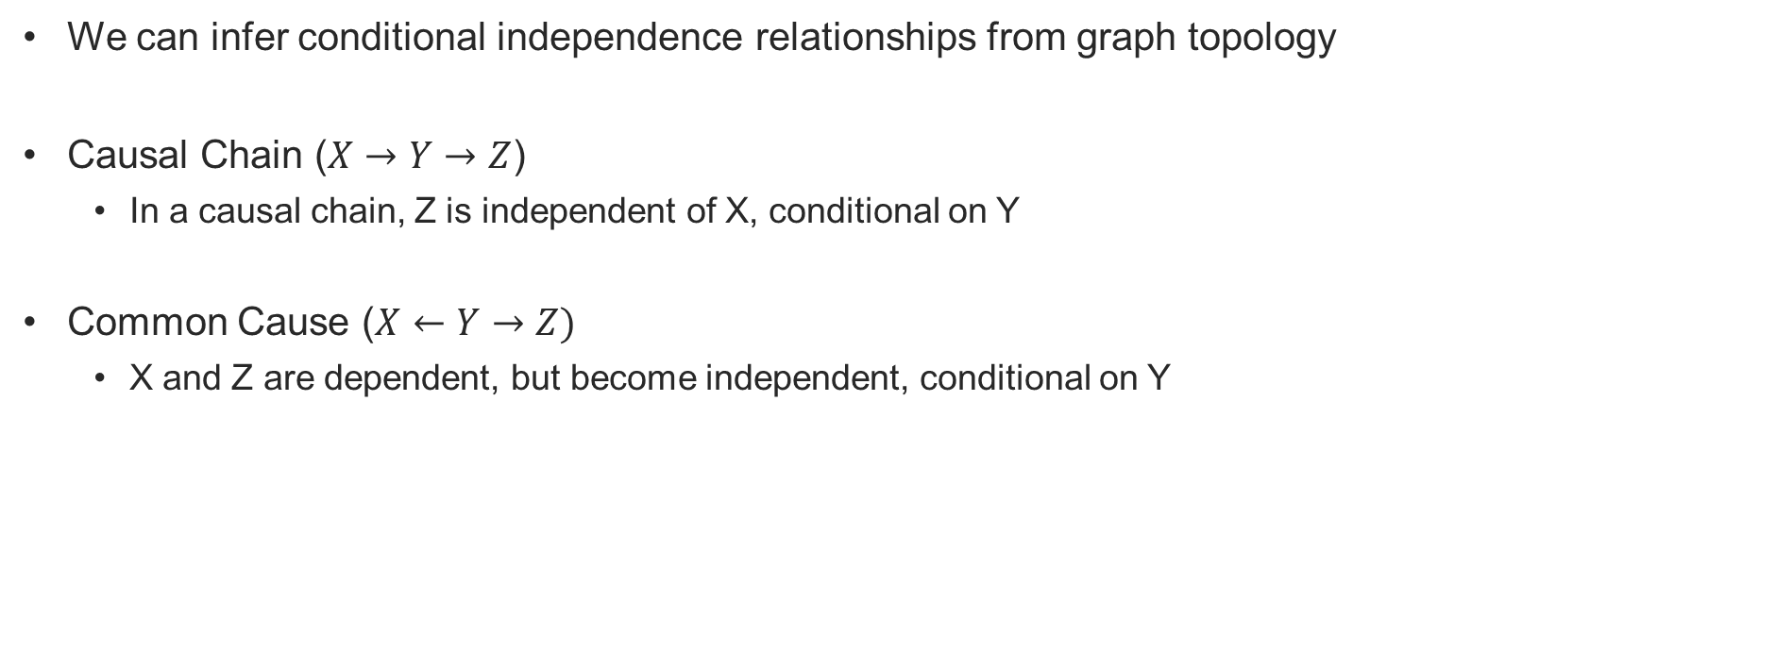
Independence and Dependence in Graphs
We can infer conditional independence relationships from graph topology
Causal Chain ($X→Y→Z$)
In a causal chain, Z is independent of X, conditional on Y
Common Cause ($X←Y→Z)$
X and Z are dependent, but become independent, conditional on Y

Slide 19
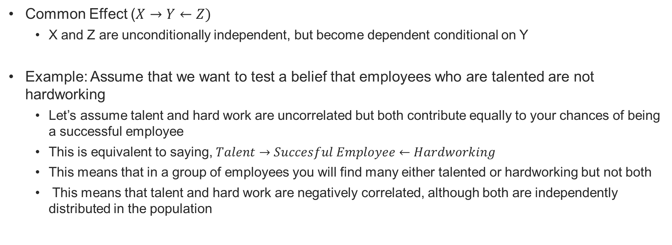
Common Effect
Common Effect ($X→Y←Z)$
X and Z are unconditionally independent, but become dependent conditional on Y
Example: Assume that we want to test a belief that employees who are talented are not hardworking
Let’s assume talent and hard work are uncorrelated but both contribute equally to your chances of being a successful employee
This is equivalent to saying, $Talent→Succesful Employee←Hardworking$
This means that in a group of employees you will find many either talented or hardworking but not both
This means that talent and hard work are negatively correlated, although both are independently distributed in the population

Slide 20
d-connection and d-separation
d-separation stands for dependency-separation or directional-separation
Two nodes X and Y are d-separated if information on X does not influence Y, and vice versa
If two nodes are d-separated, the variables they represent are independent
X and Y are d-connected if information on X influences Y, and vice versa

Slide 21
Causal Chain
A
Hard evidence entered in A is transmitted to C but blocks any evidence from B from reaching C
B
C
In a causal chain B and C are conditionally independent given A (or equivalently B and C are d-separated given A)
i.e. changing B will not affect C nor A (which is instantiated)

Slide 22
Common Cause
A
Hard evidence entered in A is transmitted to C but blocks any evidence from B from reaching C
B
C
In a common cause connection B and C are conditionally independent given A (or equivalently B and C are d-separated given A)
i.e. changing B will not affect C nor A (which is instantiated)

Slide 23
Common Effect
A
Any evidence entered in A is transmitted to both B and C
B
C
In a common effect connection B and C are conditionally dependent given A (or equivalently B and C are d-connected given A)
i.e. changing B will affect C and A if A is instantiated with any evidence

Slide 24
d-connection and d-separation example
An observation is set on variable B. Are variables A and E d-connected given B?
Yes, A and C become dependent given B, and C and E are dependent via common cause D
E
A
D
C
B

Slide 25
Interventions
The primary purpose of causal inference is to predict the results of an intervention
An intervention represents a manipulation of a variable in the model
The do-operator:
P(Y|do(X=x)) means the probability distribution of Y if we set X to the value x
In graphical models, intervening on a variable X is equivalent to removing all edges that go into X
Pre-intervention
Post-intervention
Z
Z
X
Y
X
Y

Slide 26
Causal Effect
The causal effect of X on Y is denoted by P(Y|do(X))
For each realization x of X, P(Y|do(X=x)) gives the probability of Y=y induced by deleting from the model all the equations corresponding to variables in X and substituting X=x in the remaining equations

Slide 27
Estimating Causal Effects
We always have the option of setting up a randomized control trial. However, this is sometimes unfeasible due to ethical concerns or sometimes is just too expensive
How can we then identify the effect of interventions purely from observational data?
We want to estimate P(Y|do(X)) but we only know P(X,Y,Z)
We also know P(Y|do(X)) is different from P(Y|X) (we all heard correlation is not causation)
Therefore, the challenge is to transform P(Y|do(X)) to an expression that contains information we actually observe in our data

Slide 28
Questions?

Slide 29
Constraint-Based Learning
Bruno Petrungaro
Senior Healthcare Analyst – Econometrician
The Health Economics Unit

Slide 30
1.3 - Connecting a model to reality Scott Venners
https://www.youtube.com/watch?v=m0xXeQzY7qc

Slide 31
Where have the graphs come from so far?
DAGs so far have been a model of how we think the world works
Consulting experts to build the DAG is a perfectly valid approach that it is used (where expert can also be a literature review)
DAGs create testable implications based on d-separation relations implied by the model
If the data does not match these implications, we may want to reconsider the graph we have built or question the data

Slide 32
Testable Implications of DAGs
C
This DAG implies the following independence relationships in the data:
A is independent of D
E is conditionally independent of B given A,C,D
B is independent of D
B
D
A
E

Slide 33
The structure of DAGs
Three ways of building the structure:
Knowledge-Based: The structure of the model is determined from knowledge
Data-driven: The structure of the model is automatically learned from available data
Information fusion: Combining approach 1 and 2

Slide 34
Learning the structure from data
Two types of algorithms:
Constraint-based or Causal Discovery: They perform conditional dependency tests, usually in sets of triples
Score-based: They search for different graphs and score them in terms of how well the fitting distributions agree with the empirical distributions

Slide 35
The PC algorithm
Starts by drawing a complete undirected graph with edges drawn between all of the variables
X2
X1
X3
X4

Slide 36
The PC Algorithm II
Performs conditional independence tests and removes edges whenever two nodes are independent
For each triple of nodes attempts to direct the edges
In summary, the PC algorithm:
Finds all conditional independence relationships in the data and constructs a graph that is compatible with these

Slide 37
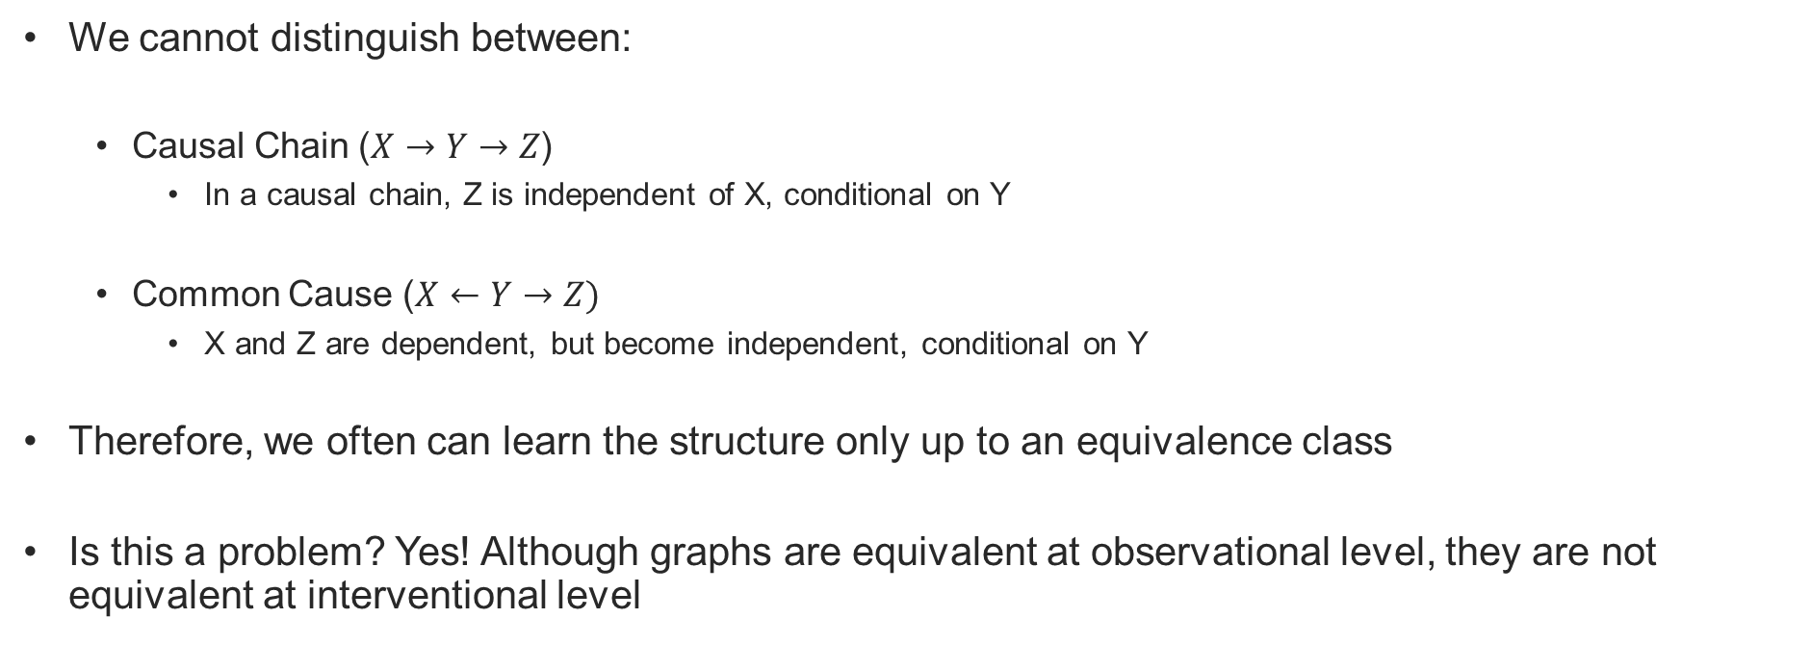
Limitations of the PC Algorithm
We cannot distinguish between:
Causal Chain ($X→Y→Z$)
In a causal chain, Z is independent of X, conditional on Y
Common Cause ($X←Y→Z)$
X and Z are dependent, but become independent, conditional on Y
Therefore, we often can learn the structure only up to an equivalence class
Is this a problem? Yes! Although graphs are equivalent at observational level, they are not equivalent at interventional level

Slide 38
Questions?

Slide 39
Confounding
Bruno Petrungaro
Senior Healthcare Analyst – Econometrician
The Health Economics Unit

Slide 40
Confounding Bias
The problem of confounding:
Paths between treatment X and outcome Y that are not originated from X and generate an association between X and Y that is not causal
Z
X
Y
We can block the biasing path by conditioning on Z (d-separation)

Slide 41
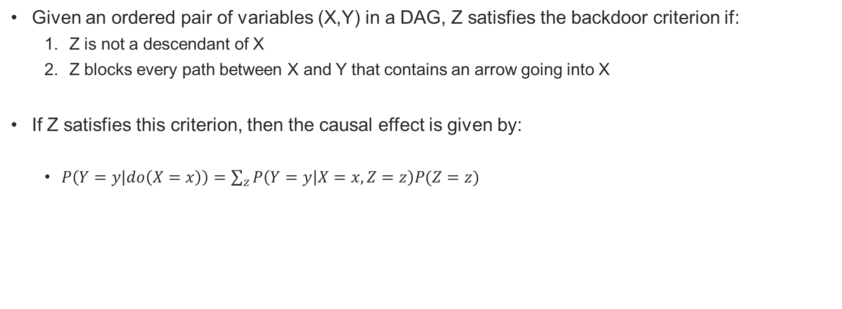
The Backdoor Criterion
Given an ordered pair of variables (X,Y) in a DAG, Z satisfies the backdoor criterion if:
Z is not a descendant of X
Z blocks every path between X and Y that contains an arrow going into X
If Z satisfies this criterion, then the causal effect is given by:
$P\left(Y=y | do\left(X=x\right)\right)=\sum_{z}{P\left(Y=y | X=x,Z=z\right)P(Z=z})$

Slide 42
Applying The Backdoor Criterion
It is not necessary to condition on all variables in the model
Keep that in mind next time you are building a regression
When many variables satisfies the backdoor criterion, choose the smallest possible set of variables
You will have to collect less data
Important if you have small sample
Z
X
Y
W

Slide 43
Estimation
Once we have found the set of variables that satisfies the Backdoor Criterion, we can estimate the causal effect. It can be something as easy as a linear regression if you are willing to make the assumptions or other methodologies you will see in this learning set
The set of variables that satisfies the Backdoor Criterion allows you as a researcher to comply with the unconfoundedness assumption required by most estimation procedures you will see in this course/learning set
Unconfoundedness: treatment has to be independent of potential outcomes conditional on a set of control variables
Therefore, you will be able to use the estimators based on unconfoudedness you will see in this course/learning set

Slide 44
The Frontdoor Criterion
How can we calculate the causal effect if we don’t observe Z?
W satisfies the frontdoor criterion relative to an ordered pair of variables (X,Y) if
W intercepts all directed paths from X to Y
There is no unblocked path from X to W
All backdoor paths from W to Y are blocked by X
Z
X
Y
W

Slide 45

The Frontdoor Criterion
If Z satisfies the frontdoor criterion relative to (X,Y) and if P(x,z)>0, then the causal effect of X on Y is identifiable and is given by the formula:
$P\left(Y=y | do\left(X=x\right)\right)=\sum_{z}{\sum_{x^{′}}{P\left(Y=y | Z=z, X=x\right)P\left(X=x\right)P(Z=z|X=x)}}$

Slide 46
Do-Calculus
The front and backdoor criterions are not always applicable
Just like the front and backdoor criterions solved the confounding problem, we can also use do-calculus to solve it
The mechanics?
Apply the rules of do-calculus repeatedly until a do-expression is translated into objects we can observe

Slide 47
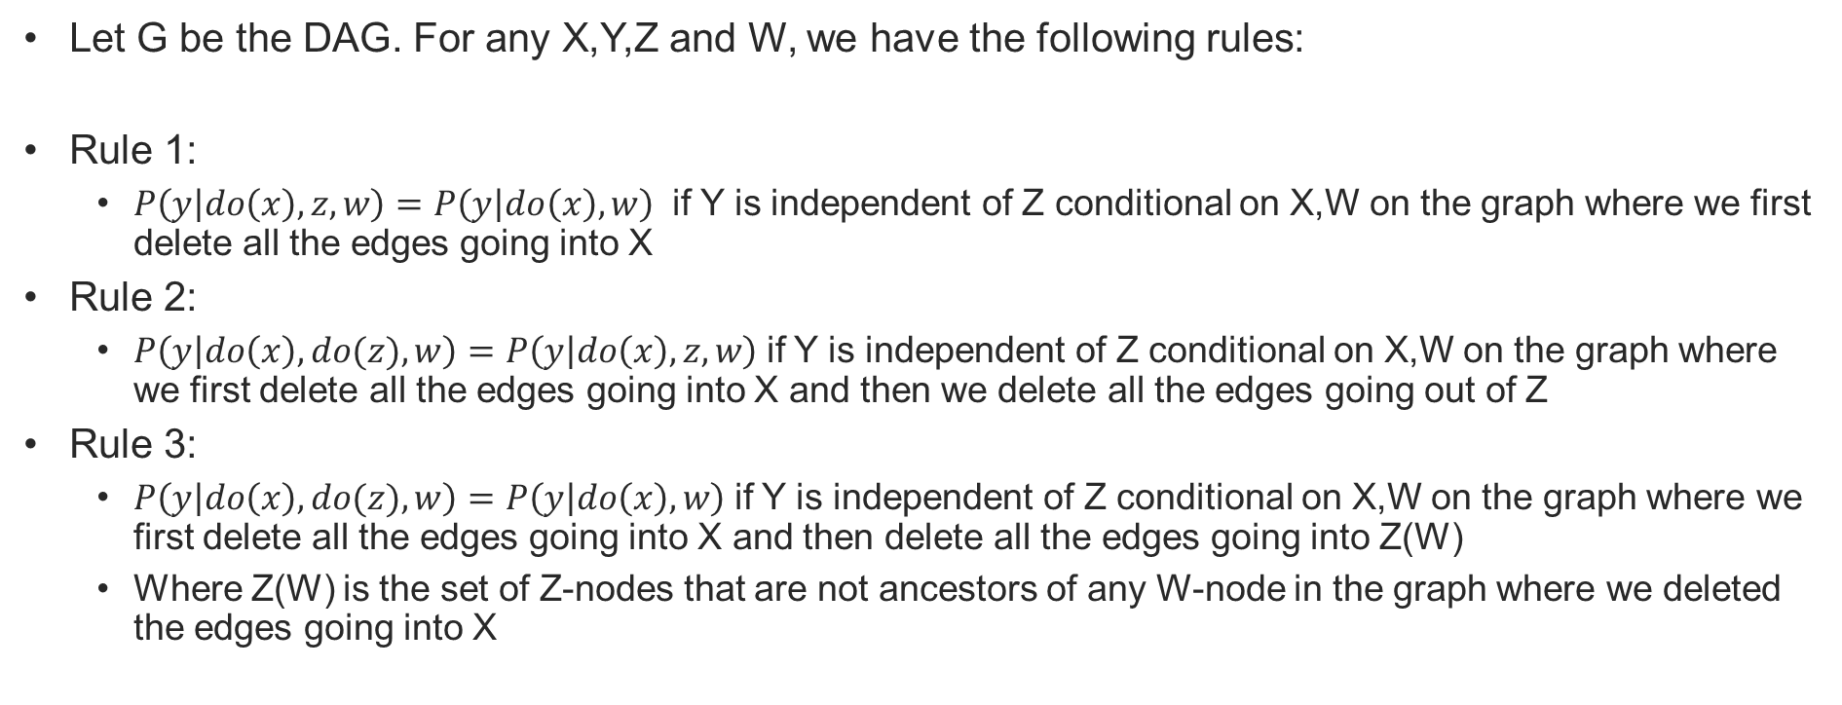
The Rules of Do-Calculus
Let G be the DAG. For any X,Y,Z and W, we have the following rules:
Rule 1:
$P\left(y | do\left(x\right),z,w\right)=P\left(y | do\left(x\right),w\right)$ if Y is independent of Z conditional on X,W on the graph where we first delete all the edges going into X
Rule 2:
$P\left(y | do\left(x\right),do(z),w\right)=P\left(y | do\left(x\right),z,w\right)$if Y is independent of Z conditional on X,W on the graph where we first delete all the edges going into X and then we delete all the edges going out of Z
Rule 3:
$P\left(y | do\left(x\right),do(z),w\right)=P\left(y | do\left(x\right),w\right)$if Y is independent of Z conditional on X,W on the graph where we first delete all the edges going into X and then delete all the edges going into Z(W)
Where Z(W) is the set of Z-nodes that are not ancestors of any W-node in the graph where we deleted the edges going into X

Slide 48
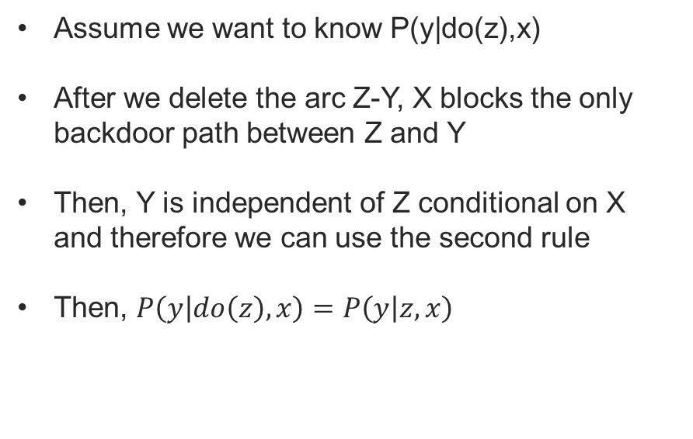
Applying the rules of do-calculus
Rule 2: $P\left(y | do\left(x\right),do(z),w\right)=P\left(y | do\left(x\right),z,w\right)$
Assume we want to know P(y|do(z),x)
After we delete the arc Z-Y, X blocks the only backdoor path between Z and Y
Then, Y is independent of Z conditional on X and therefore we can use the second rule
Then, $P\left(y | do\left(z\right),x\right)=P\left(y | z,x\right)$
X
Z
Y
X
Z
Y

Slide 49
Do-Calculus is complete
If a causal effect is identifiable, there exists a sequence of applications of the rules of do-calculus that is able to translate the do-operator into objects that are observable
If do-calculus fails, we can guarantee that the causal effect cannot be identified
Huang, Y. and Valtorta, M.: “Pearl’s calculus of intervention is complete”, Proceedings of the Twenty-Second Conference on Uncertainty in Artificial Intelligence, 2006

Slide 50
Questions?

Slide 51
Score-based learning
Bruno Petrungaro
Senior Healthcare Analyst – Econometrician
The Health Economics Unit

Slide 52
Score-based learning
Score-based: They search for different graphs and score them in terms of how well the fitting distributions agree with the empirical distributions
Represents a classical machine/statistical learning process
They are based on a search method and a scoring (objective) function
Search: methodology that determines which possible graphs to explore
Score: evaluates each graph being searched
The graph with the highest score is returned as the “best” graph

Slide 53
Hill-Climbing Search
From an initial graph (which might be empty or a best guess graph), moves to neighbouring graph that maximises the objective function
Neighbouring graphs are found by making small changes to the current “best” graph. For example:
Removing edges
Adding edges
Reversing edges
When no neighbouring graph increase the score, the search stops and the algorithm returns the graph that maximises the score
This methods generally only reaches a local maximum

Slide 54
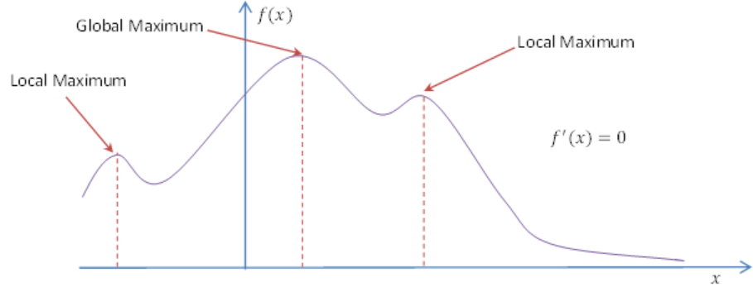
Hill-Climbing Search

Slide 55
Tabu Search
Tabu search is actually Hill-Climbing Search with modifications intended to address the key limitation of Hill-Climbing Search
When a local maximum is found the solution is entered into the Tabu list, and the initial solution is then replaced with this new solution
The algorithm will continue to move between graphs to find the global maximum
The process is repeated and the Tabu list is updated until the stopping criterion is met and the algorithm returns the graph that maximized the score

Slide 56
Introduction to Bayesian Networks
Bruno Petrungaro
Senior Healthcare Analyst – Econometrician
The Health Economics Unit

Slide 57
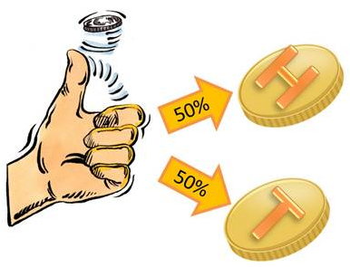
What is probability?
Probability is the term used to quantify our uncertainty about some unknown entity
Experiment: The act of tossing a coin and observing some outcome of interest, such as what side the coin lands on
Event: any actual observed value of an experiment. For example, in the experiment of rolling a die, where the outcome of interest is “the number showing on top” both “6” and “a number greater than 3” are events
Elementary Event: In the die rolling experiment, the event “6” is called an elementary event because it refers to something unique, in contrast to the event “a number greater than 3”, which can refer to 4,5,6. The set of all elementary events of an experiment is important because together they compose all the possible events

Slide 58
Let’s do an experiment
Let’s toss a coin and observe which side the coin lands on
Tell me what you got…

Slide 59
Frequentist vs Bayesian Probability
What happens if the coin lands on its side? Or gets lost?
There are three possible elementary events to this experiment: “head”, “tail” and “neither”
Assumptions made by the frequentist approach in this example:
The elementary events are all equally likely
The experiment can be repeated many times under identical conditions

Slide 60
Frequentist vs Bayesian Probability
Frequentist definition of probability: The probability of an elementary event is the frequency with which that event would be observed over an infinite number of repeated experiments
What is the probability that the coin will land on its side? Or get lost?
Frequentist probability will say that there are only two elementary events to this experiment. We cannot toss a coin repeatedly and count how many times it lands on its side. We know it is rare but we also know it might happen
We can only provide a subjective measure of uncertainty (a degree of belief) based on our current state of knowledge
This is the Bayesian definition of probability

Slide 61
Bayesian Network
Remember this slide?
This is a Bayesian Network as well
Bayesian Networks are represented by a directed acyclic graph
A
B
C
D

Slide 62
Joint Probability Distribution
C | D | P
H | 1 | 0.0833
H | 2 | 0.0833
H | 3 | 0.0833
H | 4 | 0.0833
H | 5 | 0.0833
H | 6 | 0.0833
T | 1 | 0.0833
T | 2 | 0.0833
T | 3 | 0.0833
T | 4 | 0.0833
T | 5 | 0.0833
T | 6 | 0.0833
The joint probability distribution of the coin toss and the die roll, noted as P(C,D), is the probability distribution of the combined events between the die roll and the coin toss

Slide 63
Marginalisation
C | D | P
H | 1 | 0.0833
H | 2 | 0.0833
H | 3 | 0.0833
H | 4 | 0.0833
H | 5 | 0.0833
H | 6 | 0.0833
T | 1 | 0.0833
T | 2 | 0.0833
T | 3 | 0.0833
T | 4 | 0.0833
T | 5 | 0.0833
T | 6 | 0.0833
We say P(C,D) is marginalised into P(C) by summing up the probabilities which correspond to the possible values of C, i.e. H or T
Therefore, P(C) can be marginalised into:
C | P
H | 0.5
T | 0.5

Slide 64
Conditional Probability
C | D | P
H | 1 | 0.0833
H | 2 | 0.0833
H | 3 | 0.0833
H | 4 | 0.0833
H | 5 | 0.0833
H | 6 | 0.0833
T | 1 | 0.0833
T | 2 | 0.0833
T | 3 | 0.0833
T | 4 | 0.0833
T | 5 | 0.0833
T | 6 | 0.0833
Conditional probability is the probability of a variable given a known state, or a set of known states, of some other variable/s
P(D|C=H) is equal to P(D) because the coin toss and die roll are independent
C | D | P
H | 1 | 0.1667
H | 2 | 0.1667
H | 3 | 0.1667
H | 4 | 0.1667
H | 5 | 0.1667
H | 6 | 0.1667

Slide 65
Prior Distribution
A prior distribution of a variable represents the expected outcomes of that variable before any observations are entered into the model
Coin toss | Probability
H | 50%
T | 50%
Die roll | Probability
1 | 16.6667%
2 | 16.6667%
3 | 16.6667%
4 | 16.6667%
5 | 16.6667%
6 | 16.6667%
You win if you get H and 6
Win | Probability
F | 91.6667%
T | 8.3333%

Slide 66
Posterior Distribution
A posterior distribution represents the revised probabilities of a variable after observations are entered into the model about some other variables
Coin toss | Probability
H | 100%
T | 0%
Die roll | Probability
1 | 16.6667%
2 | 16.6667%
3 | 16.6667%
4 | 16.6667%
5 | 16.6667%
6 | 16.6667%
You win if you get H and 6
Win | Probability
F | 83.3333%
T | 16.6667%

Slide 67
Explaining away
The concept of explaining away is a pattern of reasoning where revised beliefs of one cause influence the beliefs of some other independent cause. This way of reasoning is unique to Bayesian Networks
Coin toss | Probability
H | 100%
T | 0%
Die roll | Probability
1 | 20%
2 | 20%
3 | 20%
4 | 20%
5 | 20%
6 | 0%
You win if you get H and 6
Win | Probability
F | 100%
T | 0%
Outcome 6 has been explained away

Slide 68

Bayes’ Theorem
$P\left(H | E\right)=\frac{P\left(E | H\right)P(H)}{P(E)}$
https://www.youtube.com/watch?v=HZGCoVF3YvM

Slide 69
References
Bruno Petrungaro
Senior Healthcare Analyst – Econometrician
The Health Economics Unit

Slide 70
References
Hunermund, Paul, Paul Hünermund (p-hunermund.com)
Pearl, Judea, “Causality: models, reasoning, and inference”, Cambridge University Press, 2009
Pearl, Judea, “An Introduction to Causal Inference”, 2015
Pearl, Judea &, Mackenzie, Dana, “The Book of Why”, Penguin Books, 2019
Pearl, Judea, “Probabilistic Reasoning in Intelligent Systems”, Morgan Kaufmann Publishers, Inc., 1986
Pearl, Judea, Glymour, Madelyn & Jewell, Nicholas P., “ Causal Inference in Statistics A Primer”, Wiley, 2016
Data Analytics, QMUL

Slide 71
Thank you!
bruno.petrungaro@nhs.net
midlandsandlancashirecsu.nhs.uk

